Slide 1

Clothing Classification
Deeb Learning

Slide 2
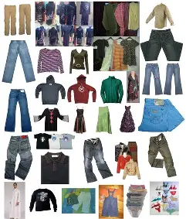
Problem Definition (Task Definition)
This project aims to develop a deep learning-based model to classify clothing images into one of ten distinct categories, including: dress, hat, longsleeve, outwear, pants, shirt, shoes, shorts, skirt, and t-shirt.
This task falls under the scope of Image Classification using Convolutional Neural Networks (CNNs), a common application in computer vision for fashion and e-commerce industries.

Slide 3

Dataset Description
Validation(341)
A dataset containing images of clothing items across ten categories was used, divided into training, validation, and test sets.
Dataset Statistics:
Training images: 3,068
Validation images: 341
Test images: 372
Train(3068)
Test (372)

Slide 4



🧠 Model Description
Base Model: A Convolutional Neural Network (CNN) with Batch Normalization and Dropout
Think of this model as a smart kid learning to identify clothing types from images.

Slide 5
1. How Does the Model Learn?
🔹 1. Input
🔹 2. Forward Pass
🔹 3. Loss Calculation
The model receives an image (e.g., a shirt) resized to 224x224x3.
The image passes through convolutional layers that extract features (edges, shapes, patterns).
At the end, the model outputs probabilities for each class (e.g., 70% shirt, 20% t-shirt, 10% pants).
The model compares its prediction with the true label using a loss function, like CrossEntropyLoss, to calculate the error.

Slide 6

1. How Does the Model Learn?
🔹 4. Backward Pass (Backpropagation)
🔹 5. Weights Update
🔁 This process repeats for thousands of images across many epochs, improving the model's accuracy over time.
The error is sent backward through the network to calculate how each weight contributed to the error.
Using an optimizer like SGD, the model updates its weights to reduce the error in the next prediction.

Slide 7
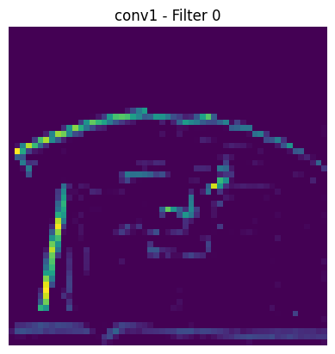
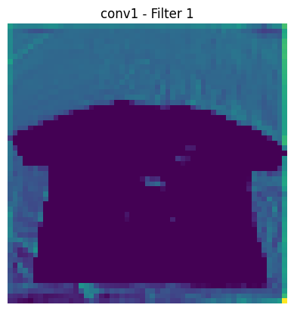
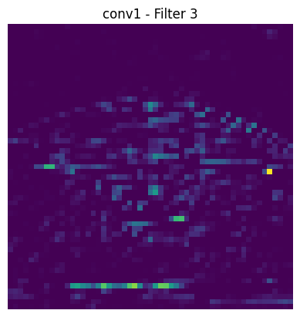
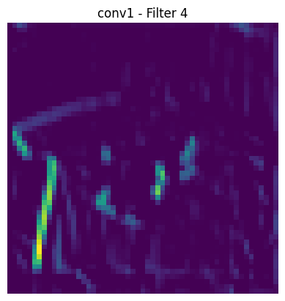
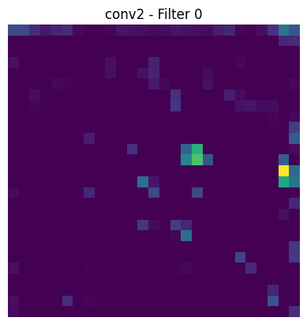
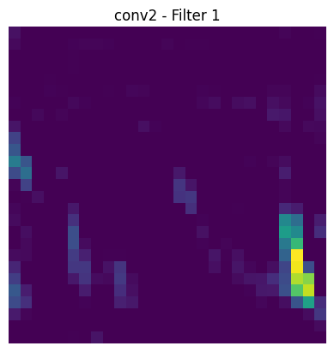
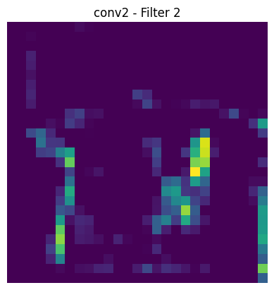
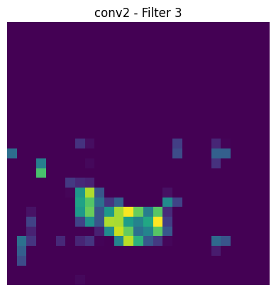
📌 Mini Example:
Conv(1)
Conv(2)

Slide 8
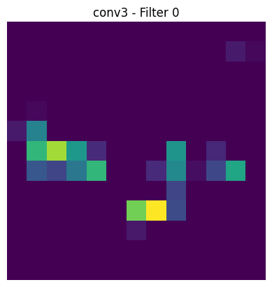
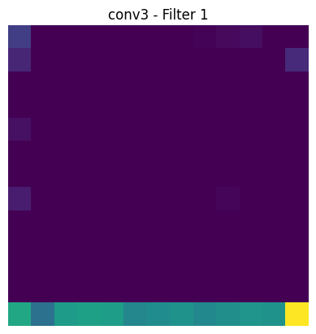
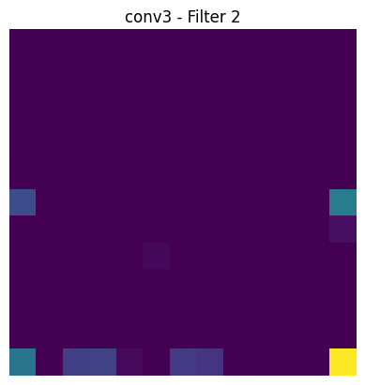
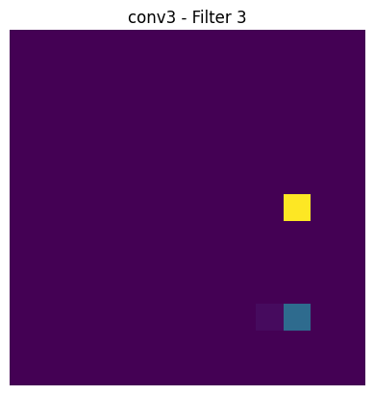
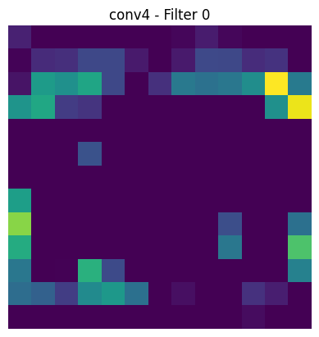
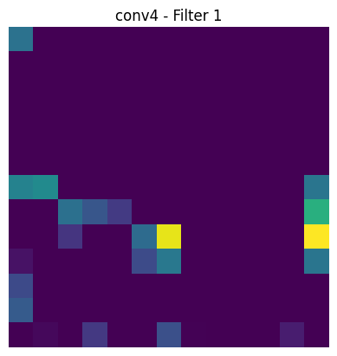
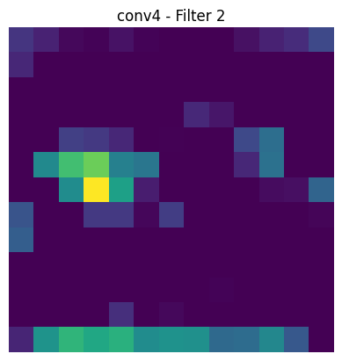
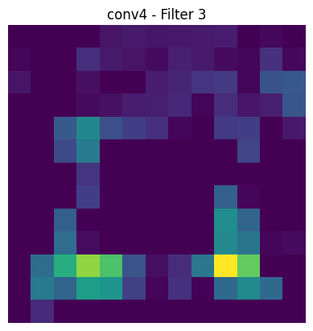
Conv(3)
Conv(4)

Slide 9
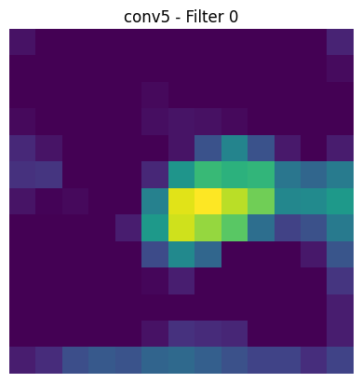
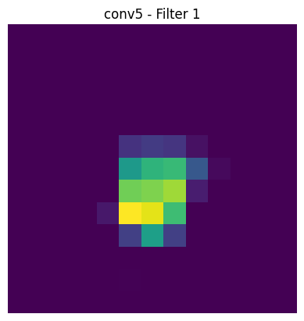
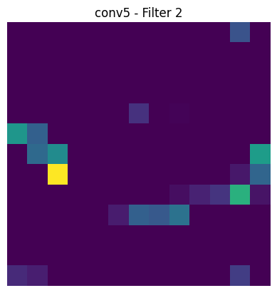
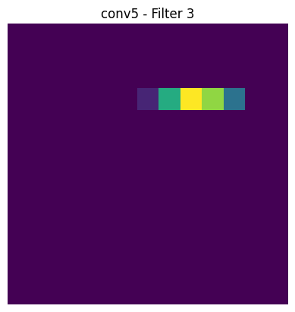
Conv(5)

Slide 10
Model Architecture (Sequential (1))
Layer Name | Output Shape | Parameters | Description
Conv2D (1) | (254, 254, 16) | 160 | Filters + ReLU
MaxPooling2D (1) | (127, 127, 16) | 0 | Downsampling
BatchNorm (1) | (127, 127, 16) | 64 | Normalize feature maps
Conv2D (2) | (125, 125, 32) | 4,640 | More filters
MaxPooling2D (2) | (62, 62, 32) | 0 | Downsampling
BatchNorm (2) | (62, 62, 32) | 128
Conv2D (3) | (60, 60, 64) | 18,496 | Extract deeper features
MaxPooling2D (3) | (30, 30, 64) | 0
BatchNorm (3) | (30, 30, 64) | 256
Conv2D (4) | (28, 28, 256) | 147,712 | Larger number of filters
MaxPooling2D (4) | (14, 14, 256) | 0
BatchNorm (4) | (14, 14, 256) | 1024
Conv2D (5) | (12, 12, 512) | 1,180,160 | Very deep representation
MaxPooling2D (5) | (6, 6, 512) | 0
BatchNorm (5) | (6, 6, 512) | 2048
Flatten | (18432) | 0 | Flatten for dense layers
Dense (1) | (256) | 4,718,848 | Fully connected layer + Dropout
Dense (2) | (128) | 32,896
Dense (Output) | (10) | 1,290 | Final prediction layer

Slide 11
Evaluation Metrics (Training & Validation Accuracy/Loss)
Epoch | Train Accuracy | Val Accuracy | Train Loss | Val Loss
1 | 0.2291 | 0.2463 | 4.4706 | 2.8288
2 | 0.3640 | 0.3783 | 2.5065 | 1.7839
3 | 0.4477 | 0.5103 | 1.7396 | 1.5497
4 | 0.5341 | 0.5425 | 1.4574 | 1.3971
5 | 0.5766 | 0.5484 | 1.3098 | 1.3685
6 | 0.6411 | 0.6305 | 1.1385 | 1.1789
7 | 0.6886 | 0.6276 | 0.9489 | 1.1540
8 | 0.7225 | 0.6774 | 0.8845 | 1.0985
9 | 0.7561 | 0.7126 | 0.7443 | 0.9300
10 | 0.7756 | 0.6921 | 0.6381 | 0.9839
✅ Best epoch was epoch 9 with Val Accuracy = 71.26%.

Slide 12
Model Architecture (Sequential (2))
Layer Type | Output Shape | Parameters | Description
Conv2D (16 filters) | (254, 254, 16) | 160 | Extracts 16 feature maps using 3x3 filters
MaxPooling2D | (127, 127, 16) | 0 | Reduces spatial dimensions (2x2 pooling)
BatchNormalization | (127, 127, 16) | 64 | Normalizes activations to stabilize training
Conv2D (32 filters) | (125, 125, 32) | 4,640 | Extracts 32 deeper features
MaxPooling2D | (62, 62, 32) | 0 | Reduces feature map size
BatchNormalization | (62, 62, 32) | 128 | Stabilizes and accelerates convergence
Conv2D (64 filters) | (60, 60, 64) | 18,496 | Learns more complex features
MaxPooling2D | (30, 30, 64) | 0 | Downsamples the output
BatchNormalization | (30, 30, 64) | 256 | Normalizes output activations
Conv2D (256 filters) | (28, 28, 256) | 147,712 | Detects high-level features
MaxPooling2D | (14, 14, 256) | 0 | Reduces spatial dimensions
BatchNormalization | (14, 14, 256) | 1,024 | Improves training stability
Conv2D (512 filters) | (12, 12, 512) | 1,180,160 | Captures very deep features
MaxPooling2D | (6, 6, 512) | 0 | Downsamples final feature maps
BatchNormalization | (6, 6, 512) | 2,048 | Final batch normalization before flattening
Flatten | (18,432) | 0 | Converts 3D data to 1D for dense layers
Dense (256 units) | (256) | 4,718,848 | Fully connected layer for learning combinations
Dropout (rate=0.5) | (256) | 0 | Reduces overfitting
Dense (128 units) | (128) | 32,896 | Further feature compression

Slide 13
Evaluation Metrics (Training & Validation Accuracy/Loss)
Epoch | Accuracy | Loss | Val Accuracy | Val Loss
1 | 0.2090 | 4.527 | 0.1584 | 5.7521
2 | 0.3329 | 2.421 | 0.2434 | 2.1889
3 | 0.4070 | 1.841 | 0.3519 | 1.8702
4 | 0.4954 | 1.582 | 0.4428 | 1.6231
5 | 0.5538 | 1.365 | 0.5132 | 1.4410
6 | 0.5710 | 1.285 | 0.5982 | 1.2684
7 | 0.6374 | 1.112 | 0.6129 | 1.1852
8 | 0.6647 | 0.992 | 0.6628 | 1.1133
9 | 0.7200 | 0.830 | 0.6100 | 1.1850
10 | 0.7619 | 0.739 | 0.6569 | 1.0865
✅ Best epoch was epoch 9 with Val Accuracy = 76.19%.

Slide 14
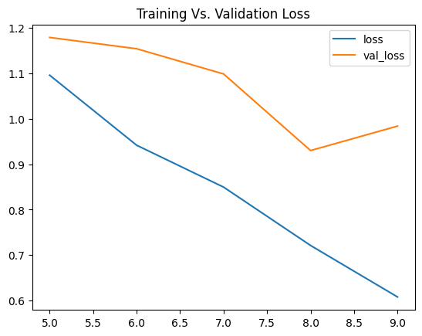
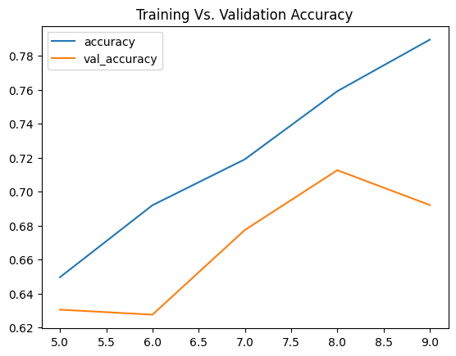
Model performance during training
Accuracy Graph
📈 "Model Learning Progress"
Blue line (Top): Training accuracy (Improved from 62% to 78%)
Orange line (Bottom): Validation accuracy (Reached 72%)
Key Insight: Closer lines = Better generalization!
Loss Graph
📉 "Mistakes Decreasing Over Time"
Blue line (Bottom): Training errors (Dropped from 1.2 to 0.6)
Orange line (Top): Validation errors (Fell to 0.7)
Warning Sign: Small gap = No overfitting!

Slide 15

⚠️ Limitations
Limited Model Accuracy:
AlexNet is an older architecture compared to modern models like ResNet or EfficientNet, which limits its performance.
Sensitive to Lighting and Background:
The model may misclassify images taken under different lighting conditions or with complex backgrounds.
Difficulty Distinguishing Similar Classes:
Some categories such as "shirt" and "t-shirt" look very similar, making it harder for the model to differentiate.
Lack of Context Understanding:
The model does not understand the context or pose of the clothing item in the image.

Slide 16

🚀 Future Work
Use of More Advanced Models:
Try more recent architectures like ResNet, DenseNet, or Vision Transformers (ViT) for improved accuracy.
Improve Data Quality:
Apply data augmentation techniques (e.g., rotation, zoom) to enhance the model’s robustness.
Multi-label Classification:
Extend the model to handle images with more than one clothing item.
Incorporate Descriptive Information:
Combine image data with textual descriptions to help the model make better decisions.
Deploy as a Web or Mobile App:
Use the trained model in a real-world application that classifies clothes automatically for users.

